Slide 1


Department of BES-1
Data Structures
24sc120
Topic:
Introduction to Graph
Session - 35

Slide 2



AIM OF THE SESSION
To familiarize students with the basic concept of Graphs and its representation
INSTRUCTIONAL OBJECTIVES
This Session is designed to:
Define a graph and its basic components.
Differentiate between types of graphs.
Explain graph representation techniques.
LEARNING OUTCOMES
At the end of this session, you should be able to:
Understand the concept of graphs
Identify different types of graphs
Learn and implement graph representations

Slide 3
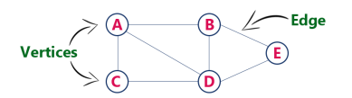
INTRODUCTION
What is a Graph?
A Graph in Data Structures is a type of non-primitive and non-linear data structue that represents a set of vertices (nodes) and edges (connections) that link pairs of vertices. It is represented as G=(V,E)
Graphs are used to model relationships or connections in a wide range of domains, such as networks, social relationships, or dependencies.

Slide 4
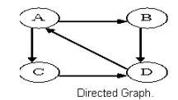
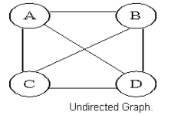
Types of Graphs
Directed Graph Vs Undirected Graph
Directed Graphs (Digraphs)
Edges have a direction, indicating a one-way connection between nodes.
Example: A flight route from City A to City B.
Undirected Graphs
Edges do not have a direction, representing a two-way connection.
Example: A friendship in a social network.

Slide 5
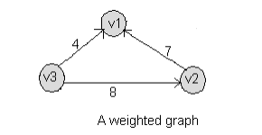
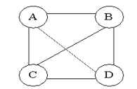
Types of Graphs
Weighted Graph Vs Unweighted Graph
Weighted Graphs
Edges have an associated weight or cost, representing the magnitude of the connection.
Example: Distances between cities on a map.
Unweighted Graphs
All edges are equal in importance or cost.
Example: A network of computers connected via cables.

Slide 6
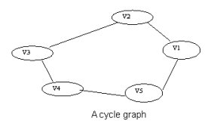
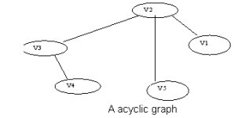
Types of Graphs
Cycle Graph Vs Acyclic Graph
Cyclic Graphs
  Contain one or more cycles (paths where the start and end nodes are the same).
  Example: A network of roads forming a loop.
Acyclic Graphs
  Do not contain cycles.
  Example: A dependency graph for tasks where no task depends on itself indirectly.

Slide 7
Graph Terminology
Vertex (Node): In graph data structures, a vertex (also known as a node) is a fundamental unit that represents an entity or point within the graph.
Edge: An Edge is a connection between two vertices in a graph. It can be either directed or undirected.
Adjacent Nodes: Two nodes are considered adjacent if they are directly connected by an edge.
Path: A path can be defined as the sequence of nodes that are followed in order to reach some destination node V from the source node U.
Degree of the Node: A degree of a node is the number of edges that are connected with that node. A node with degree 0 is called as isolated node.
In-Degree: The number of incoming edges to a vertex in a directed graph.
Out-Degree: The number of outgoing edges from a vertex in a directed graph.
Length of a path: Number of edges in the path. Sometimes the sum of the weights of the edges.

Slide 8
GRAPH REPRESENTATION
To efficiently store and process graphs, it is essential to understand different ways of representations. Some of them are
Adjacency Matrix
Adjacency List
Transitive Closure

Slide 9
Adjacency Matrix
An adjacency matrix is a 2D array that represents a graph.
  Rows and columns represent vertices.
  A cell at position (i,j) indicates whether there is an edge from vertex i to vertex j.
  For weighted graphs, the cell stores the weight of the edge; for unweighted graphs, it typically stores 1 if an edge exists, and 0 otherwise.
Example (Directed Graph):For a graph with vertices A, B, C:
Row 0 represents edges from A: A→B.
Row 1 represents edges from B: B→C.
Row 2 represents edges from C: C→A.
B
0 1 0
0 0 1
1 0 0
A
C

Slide 10
Adjacency List
An adjacency list represents a graph as a collection of lists, where each vertex has a list of its neighboring vertices.
Each vertex is a key in a dictionary (or index in an array).
The value is a list of adjacent vertices (and weights if the graph is weighted).
Example (Undirected Graph): For a graph with vertices A, B, C, D with edges A−B, B−C, C−D:
A:[B]
B:[A,C]
C:[B,D]
D: [C]
B
A
C
D

Slide 11
Transitive Closure
The transitive closure of a graph determines the reachability of nodes. It creates a new graph that shows all possible paths between nodes in the original graph.
Example (Directed Graph):For a graph with vertices A, B, C:
B
0 1 1
0 0 1
0 0 0
A
C
Row 0 represents edges from A: A→B.​
Row 0 represents edges from A: A→B & B→C.
Row 1 represents edges from B: B→C.​
Row 2 represents edges from C: [].​

Slide 12
THANK YOU
CO4 – Data Structures

